Slide 1
Ryan
Emma
Stuarts
Katelyn
Ben
Harley
Ellie
Tudor
Medieval
Joe
Kerr
Jessica
Kristi
Ella S
Ella
Tommy
Camzin
Callum
Eighteenth Century
Amber
Bradley
Luke
Jasmine
Joe
Roman and Saxon
Nineteenth Century
Ben
Nev
Lucy
Oliver W
Lucy
Leon
Hannah
Joe T
My Desk
DOOR

Slide 2
What can you see in this picture?
When do you think this painting was made?
What does it tell us about life in Portsmouth?

Slide 3
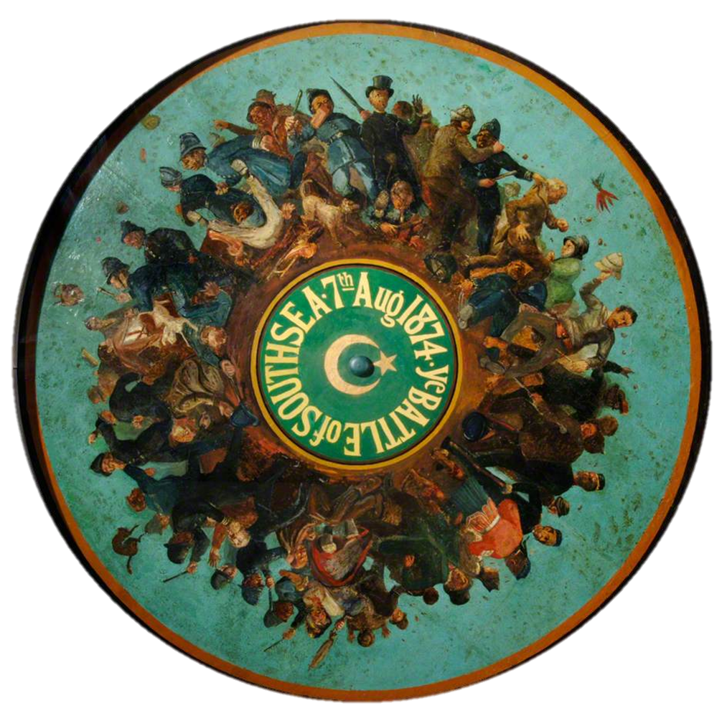
What words would you use to describe the scenes on this source?
What does this source tell us about life in Portsmouth in 1874?
What might be causing the violence?

Slide 4
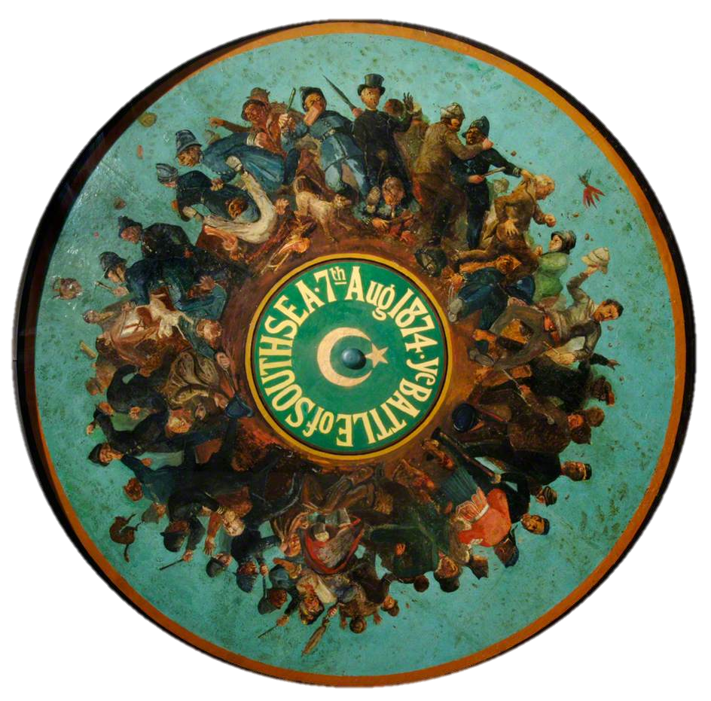
This is a mural depicting the Battle of Southsea in 1874. Many working-class inhabitants marched onto Southsea Common in protests against land being taken away for the exclusive middle-class bathing house. The result was a four day riot with the police and armed forces.

Slide 5
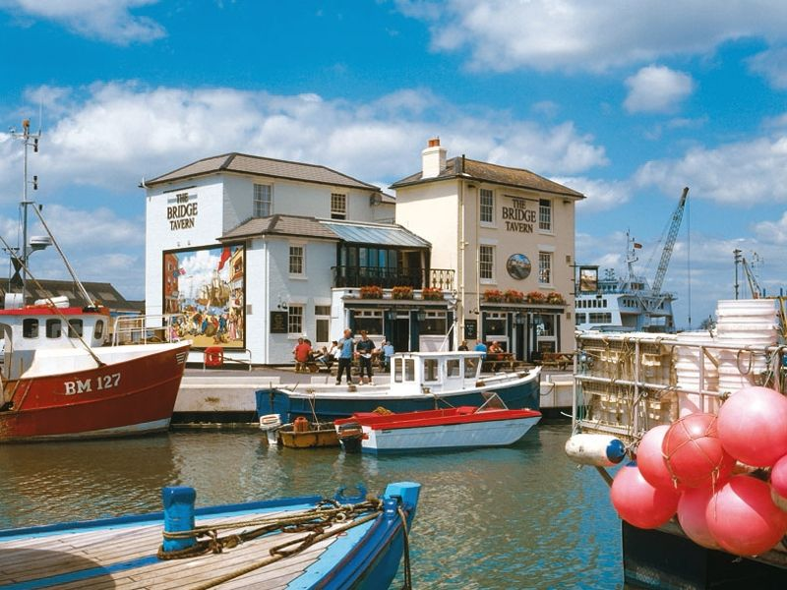
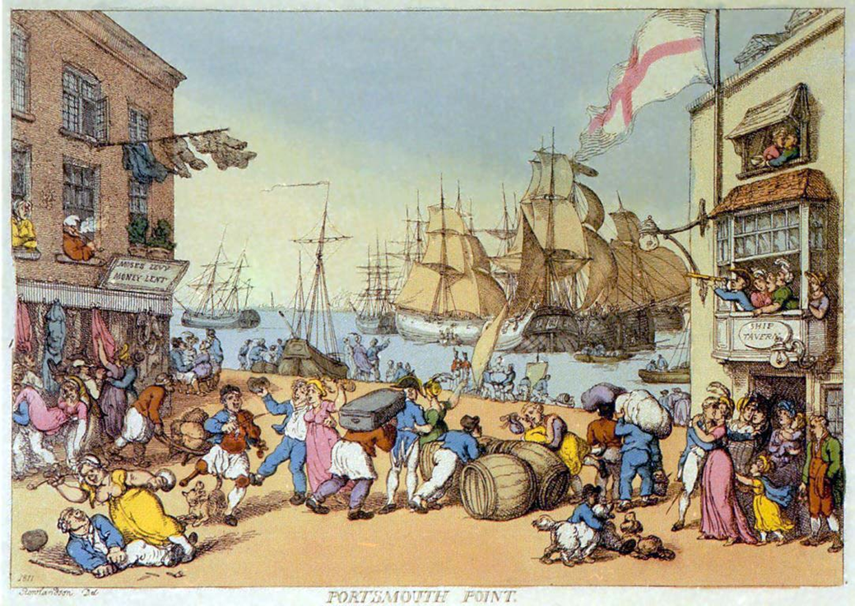
You can see this famous painting on the side of the Bridge Tavern pub on Portsmouth Point.
What can we infer about life in 18th Century Portsmouth from this painting?

Slide 6
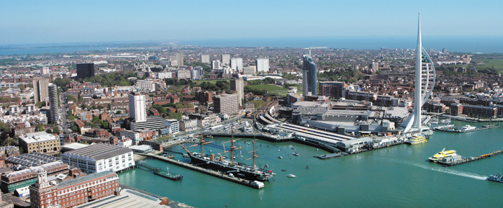
When was it best to live in the Portsmouth area?

Slide 7
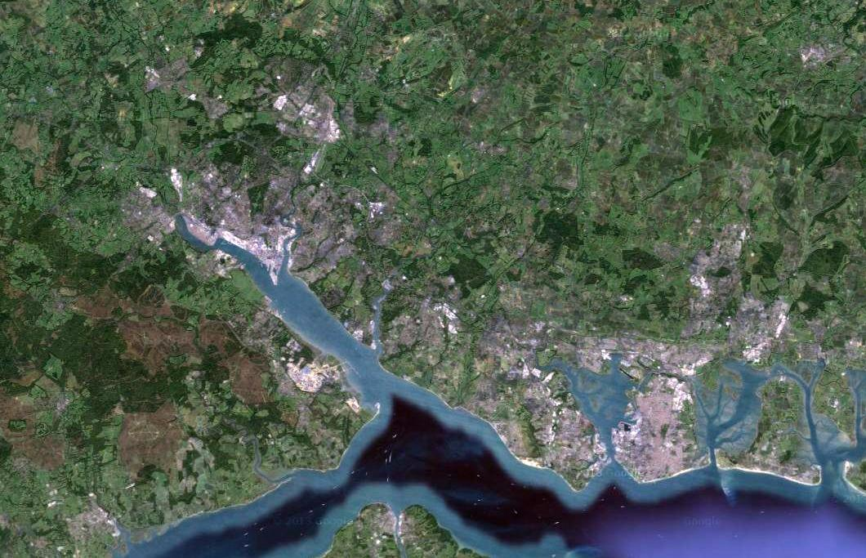
Langstone Harbour
Southampton
Gosport
Isle of Wight
Portsmouth (on Portsea Island)
Solent

Slide 8
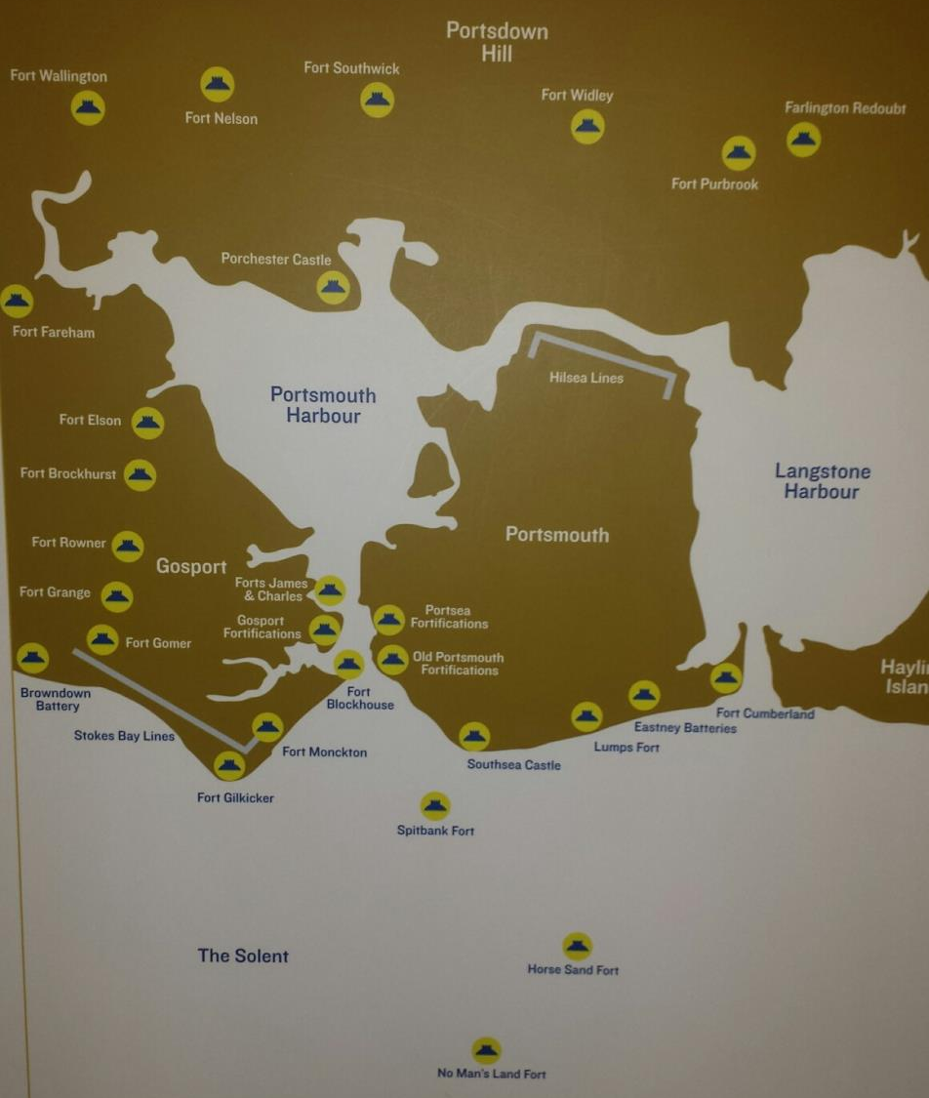
What does the high number of fortifications protecting Portsmouth suggest about its importance?
Why was Portsmouth important?
Is it’s protection a good reason to live in Portsmouth?
Is this the only factor we should consider to judge when it was best to live in Portsmouth?

Slide 9
What should we consider to judge when the best time to live in Portsmouth was?
When was it safest?
Crime rate
When was it worst?
Housing conditions
Education
When was it best to find employment?
War – good or bad impact?
Leisure
Life expectancy
Advancements in technology

Slide 10
Whilst you are researching, look out for these pointers to help you.
Wealth
Employment
Housing and living standards
Health
Safety of the people

Slide 11
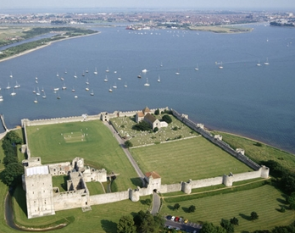
Roman Portsmouth
The Roman fort at Portchester is built between AD 285 and 290.
Why did the Romans build their fort here?
Why was access to the sea important for the Romans?
Evidence of saltworking, oyster farming and brick/tile manufacture around the Langstone Harbour area.

Slide 12
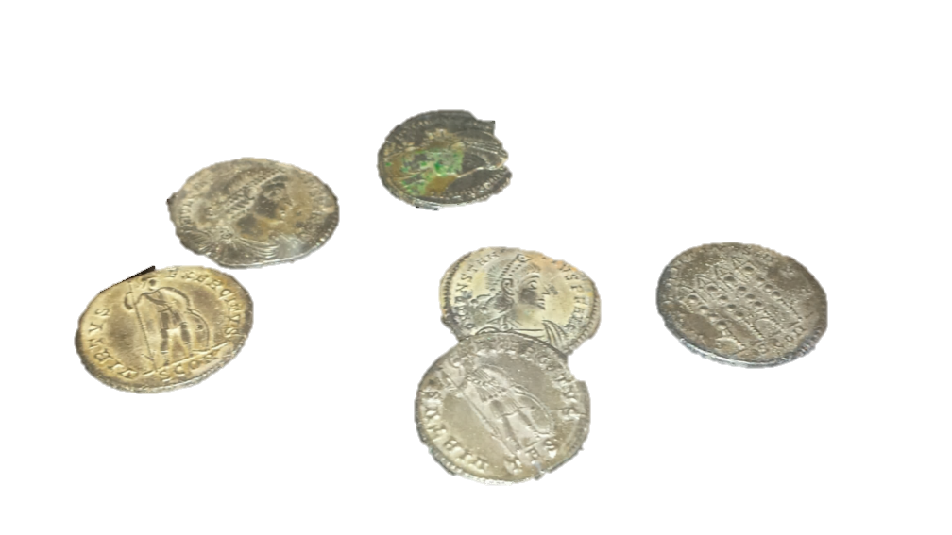
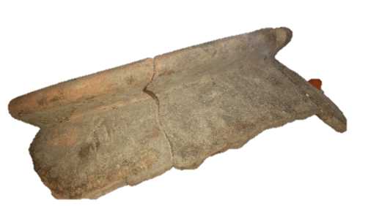
Roman Portsmouth
Rim and shoulder of Romano-British storage jar. Found at Langstone Harbour. 83-410 AD
Roman silver coins from the Southsea hoard of 1897. These are just some of the coins found during the digging of clay for brick-making in a field off Lumps Lane, now Eastern Parade. It could have been the private wealth of a local Roman dignitary. 300-400 AD
What can we infer about people’s lives in Portsmouth in this period from these objects?
This small jug was found at Northwood Farm, Forest Side, Rowlands Castle. It’s small size suggests that it was made to travel with and it was probably made at the nearby pottery kiln site in Rowlands Castle. 83-410 AD

Slide 13
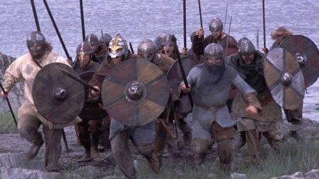
Saxon Portsmouth
892 - King Alfred strengthened the defences of Portchester.
897 - King Alfred stationing some of his fleet in Portsmouth Harbour and it is said that some of the vessels were built here to his own design; they were not shaped after the Danish or Friesian mode; but were longer with 60 oars or more, swifter and steadier. King Alfred won a complete victory over the Danes in the Solent and for a time ended the menace of the Dane.
979 - Portsea Island devastated by the Danes. Southampton sacked in 980.
998 - The Danes had returned and settled in the Isle of Wight.
1066 King Harold (Godwineson) having seized the throne after the death of Edward the Confessor, mustered the fleet (we are told of 700 vessels.) at Portchester to cruise the Channel and ward off any planned invasion threatened by Duke William of Normandy.

Slide 14
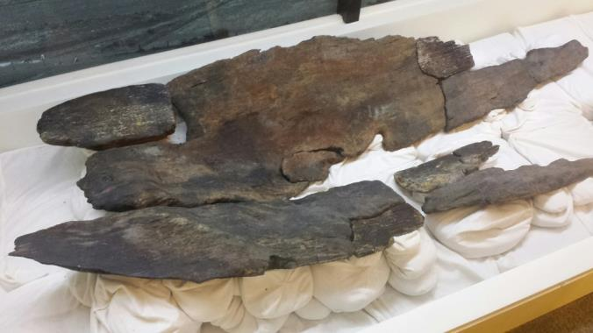
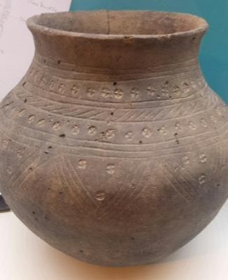
Dating to around AD500, this Saxon logboat is the oldest watercraft to have been found in the Solent. The boat would have been a simple wooden canoe, used for activities such as fishing, marsh grazing or fowling. This tells us that there was settlement in the Portsea Island area.
What do these artefacts reveal about life on Portsea Island during the Saxon period?
What can you infer about their wealth or standard of living?
Cremation urn from Old Turnpike Road Fareham
Decorated bronze strap end with horses head design, around AD 800-850. Bronze escutcheon (decorative plate) with enamel decoration from a hanging bowl, around AD 600-700.

Slide 15
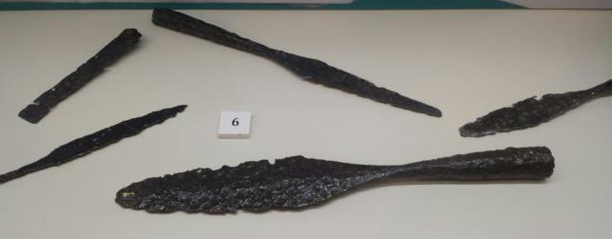
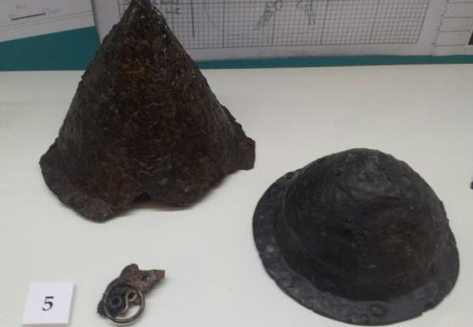
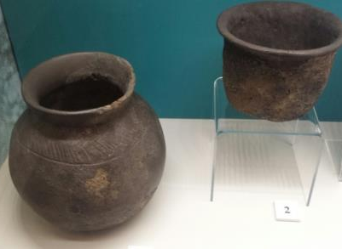
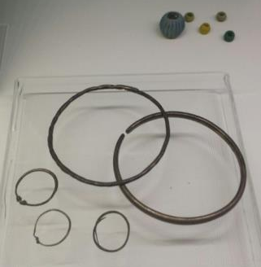
Saxon spearheads and shield bosses from ‘warrior’ burials. Two elderly males had been buried with shields and spears, and three younger males with spears and knives.
Can you infer anything about life on Portsea Island from these objects…
Safety of the people?
Employment?
Trade or Wealth?
Drinking vessels, found in the grave of an elderly women.
Bronze bracelets, rings and paste beads. The blue melon bead is Roman and had probably been passed down from previous generations.

